Slide 1
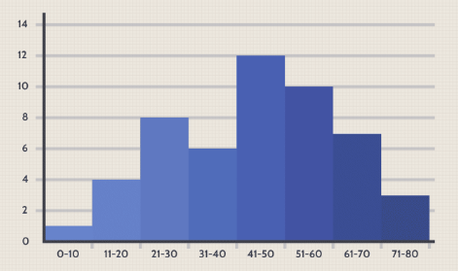
Introduction to Histograms

Slide 2
What Is Histogram?
A histogram is a graphical representation of a grouped frequency distribution with continuous classes.
It is an area diagram and can be defined as a set of rectangles with bases along with the intervals between class boundaries and with areas proportional to frequencies in the corresponding classes.
In other words, a histogram is a diagram involving rectangles whose area is proportional to the frequency of a variable and width is equal to the class interval.

Slide 3
Components of Histogram
X-axis: Visualize the X-axis as a horizontal line at the bottom of the histogram . It displays the many categories or groups that the data is sorted into.
Y-axis: The Y-axis appears as a vertical line on the side of the histogram. It displays the number of times something occurs in each category or group shown on the X-axis.
Bars: Bars are like the histogram’s building blocks. They are the vertical rectangles you see on the chart. Each bar on the X-axis represents a category or group, and its height indicates how many times something occurs inside that category.

Slide 4
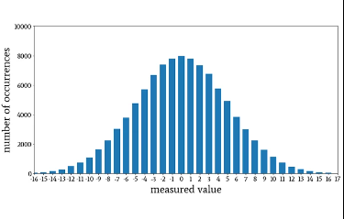
Normal Distribution Histogram
The histogram will likely be bell-shaped, indicating a normal distribution.
The highest bar (or bars) will be around the middle score range, with the height of bars decreasing symmetrically as you move away from the middle.

Slide 5
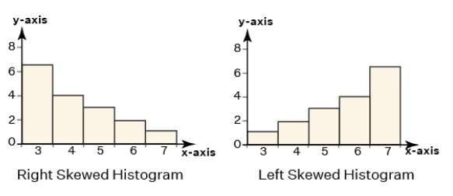
Skewed Distribution Histogram
The histogram will have a long tail to the right, indicating a right-skewed distribution.
Most of the bars will be taller on the left side of the histogram (representing younger employees), with the height of bars decreasing as you move to the right (older age groups).

Slide 6
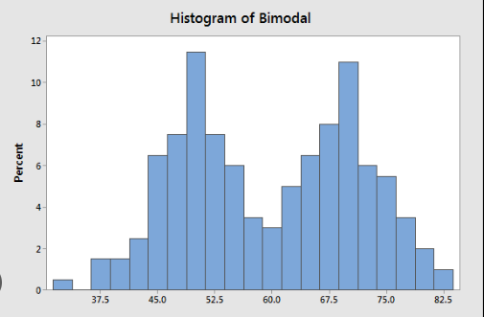
Bimodal Histogram
A histogram is called bimodal if it has two distinct peaks.
This implies that the data consists of observations from two distinct groups or categories, with notable variations between them.

Slide 7
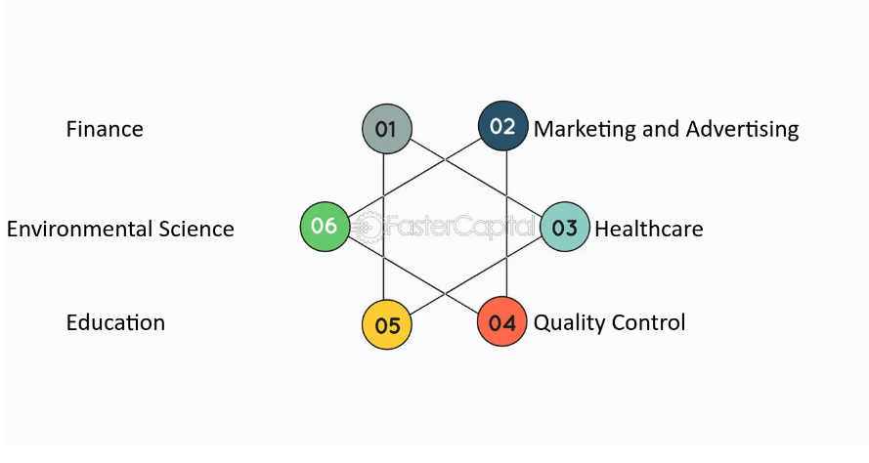
Real-life Application of histograms in Various Industries

